Slide 1


Slide 2


Slide 3
Brand | Specialization | Core Products
ROSMIKA DECOR | Architectural Surfaces | UV Wall Panels, WPC & PVC Fluted Panels, Decorative Hardware
STALLITA | Bathroom Elegance | Luxury Bathroom Vanities and Intelligent LED Mirrors
REINA | The Queen of Comfort | Premium, ergonomic, and stylish Toilet Seats
CROIA | Kitchen Innovation | Smart Sinks, Handmade Sinks, Pull-down Faucets, and Prep Bowls

Slide 4
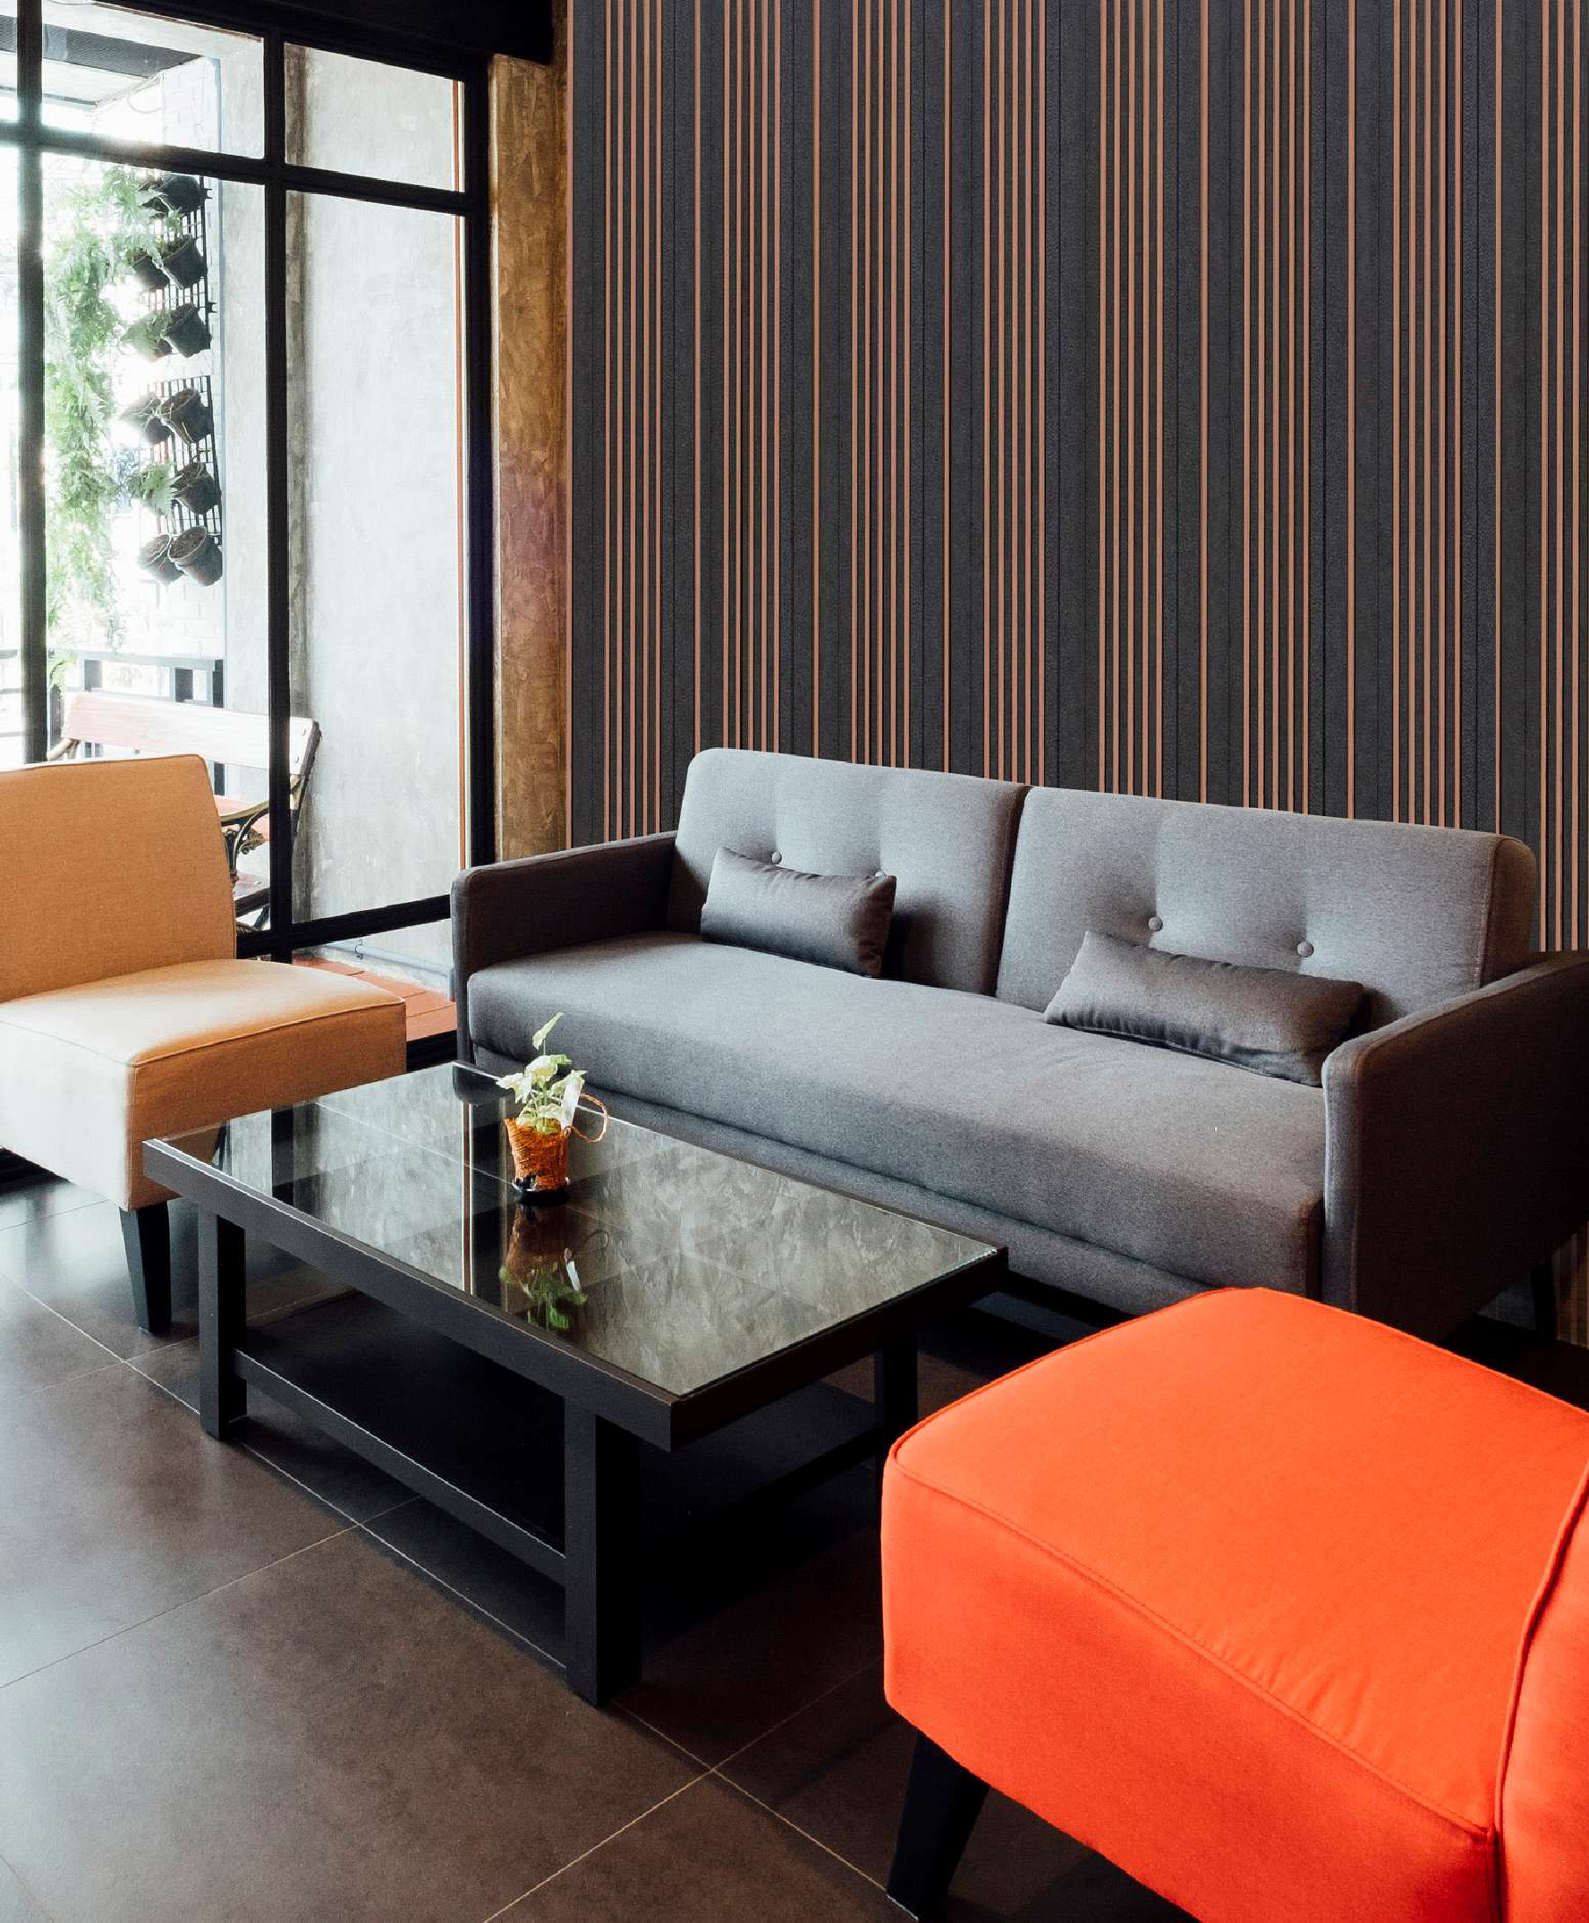

ROSMIKA DÉCOR : The Art of the Surface
“Redefining the walls that surround you.” Rosmika Decor is where texture meets technology. Specializing in high-performance UV wall panels and WPC/PVC fluted panels, we provide the architectural "wow factor" for modern interiors. Whether it’s a sleek commercial lobby or a cozy residential feature wall, Rosmika offers the hardware and surfaces that turn plain spaces into design statements.

Slide 5

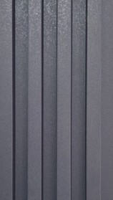
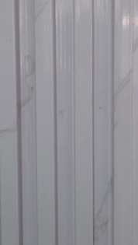
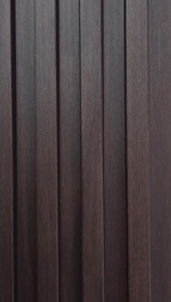
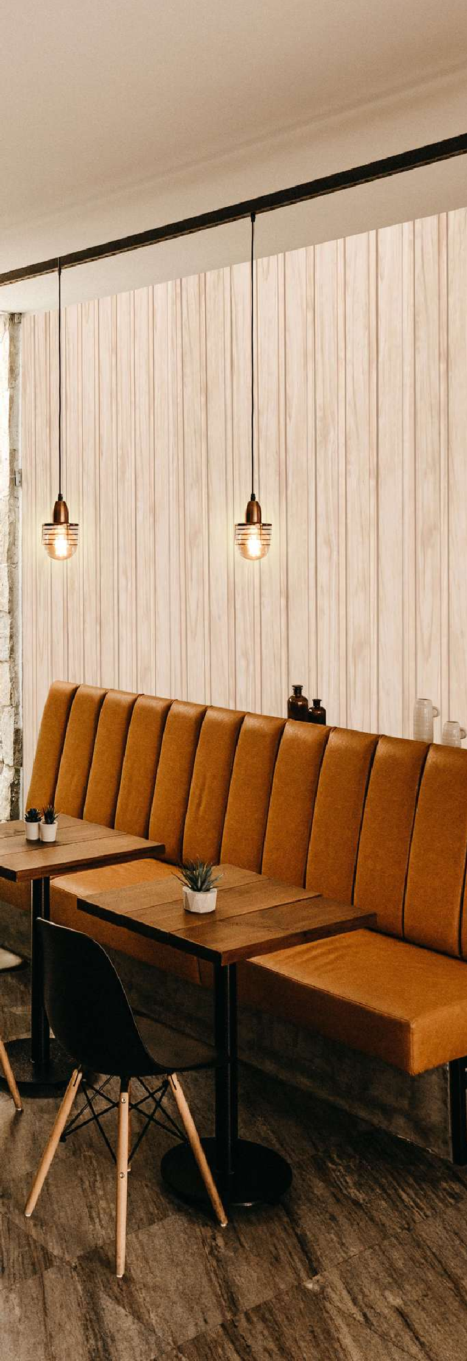
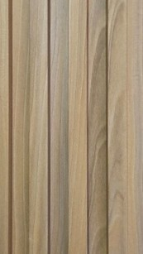
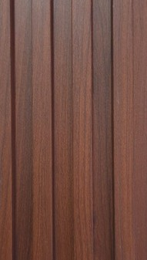
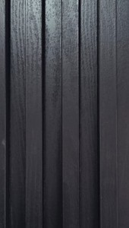
FLUTED WPC WALL PANEL 2900 X 160 X 22mm
RS01
RS02
RS03
RS04
RS05
RS06

Slide 6
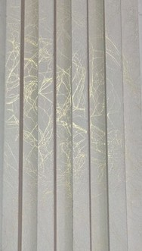
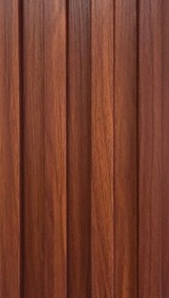
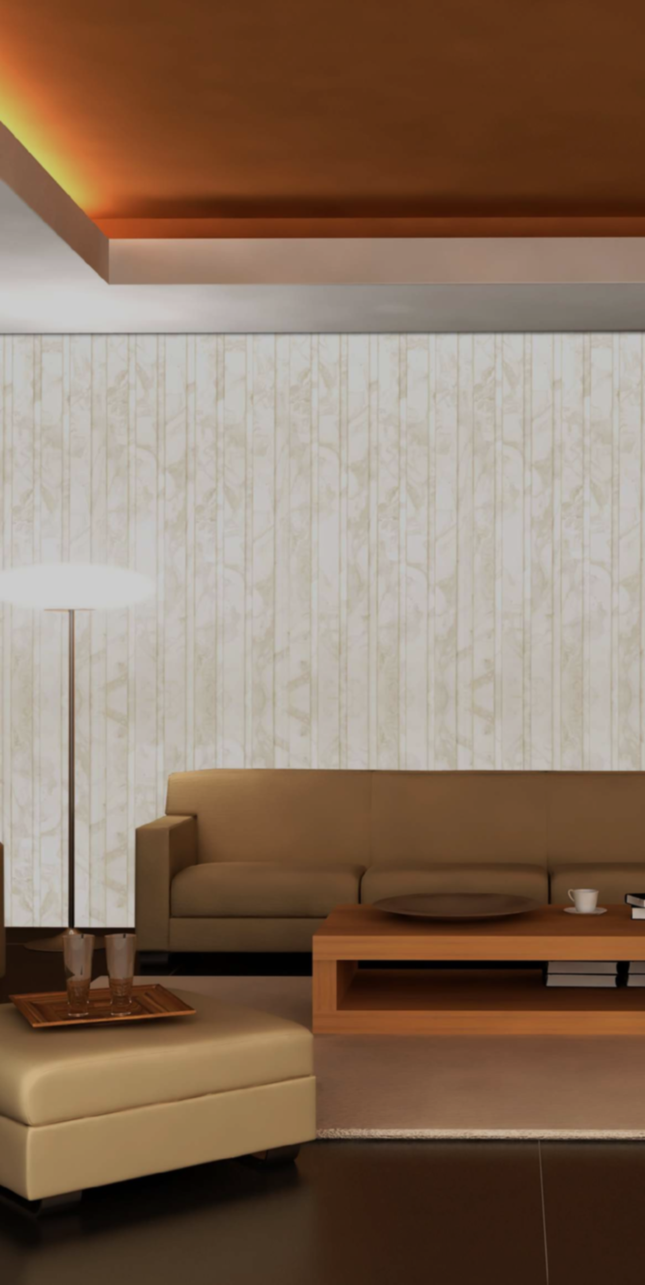
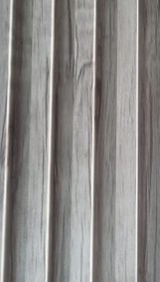
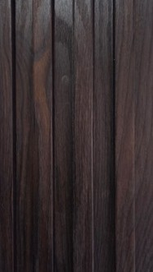
FLUTED WPC WALL PANEL 2900 X 160 X 22mm
RS07
RS08
RS09
RS10

Slide 7
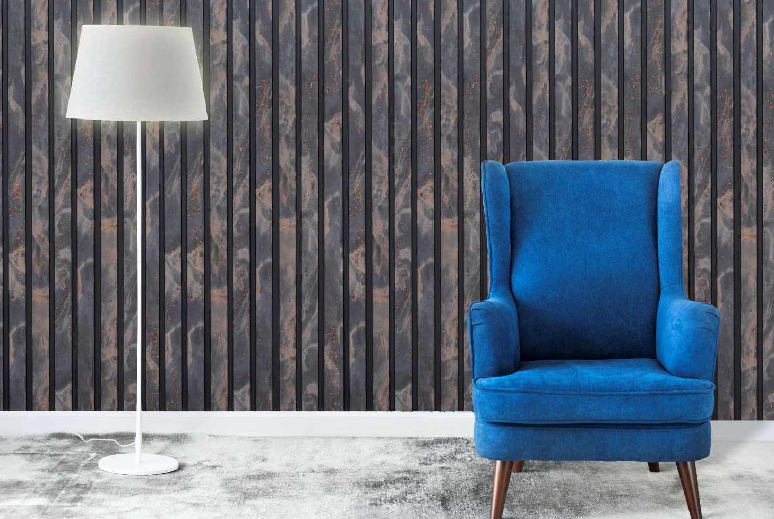
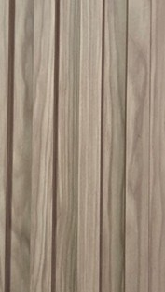
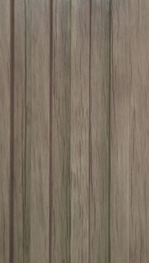
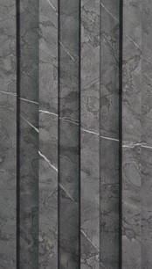
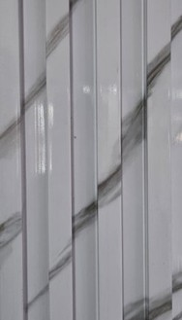
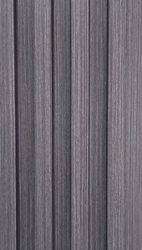
FLUTED WPC WALL PANEL 2900 X 160 X 22mm
RS11
RS12
RS13
RS14
RS15

Slide 8
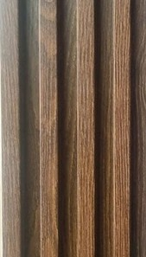
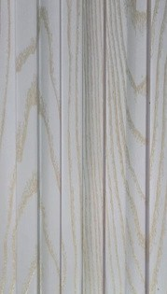
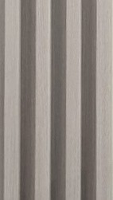
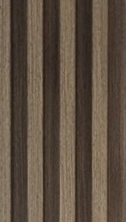
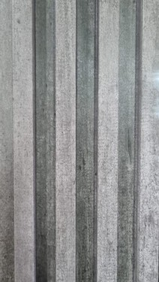
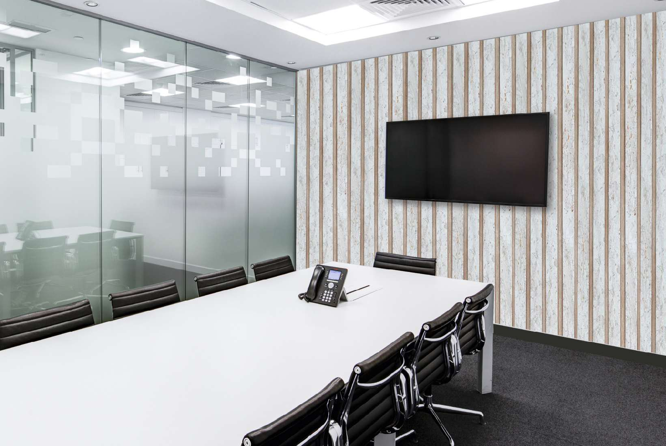
FLUTED WPC WALL PANEL 2900 X 160 X 22mm
RS16
RS17
RS18
RS19
RS20

Slide 9
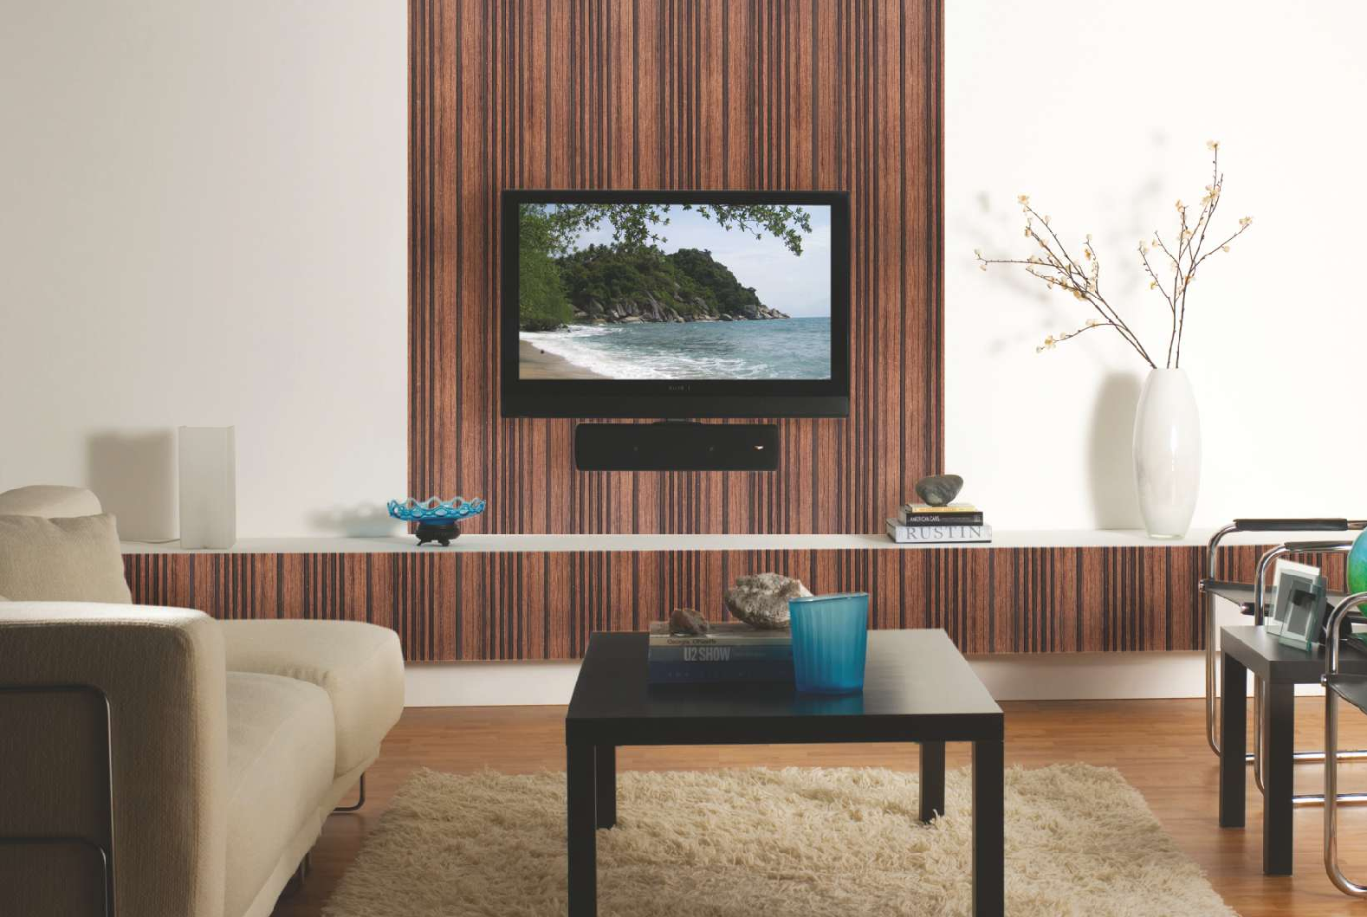
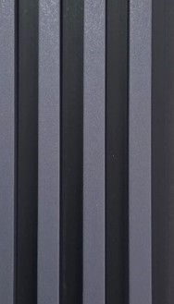
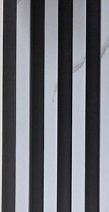
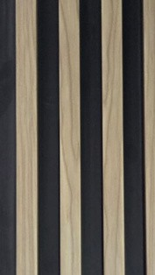
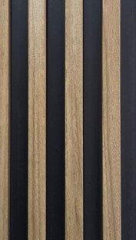
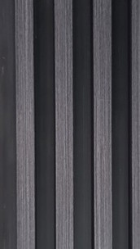
FLUTED WPC WALL PANEL ( 2 TONE ) 2900 X 160 X 22mm
RS21B
RS22B
RS23B
RS24B
RS25B

Slide 10
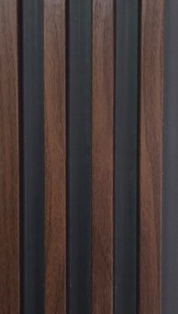
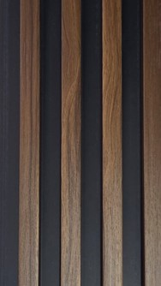
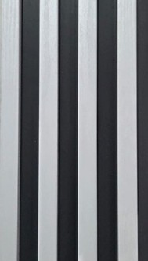
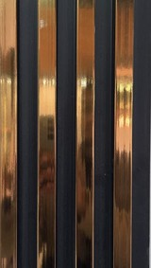
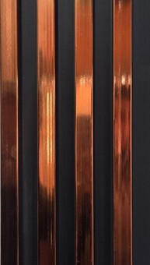
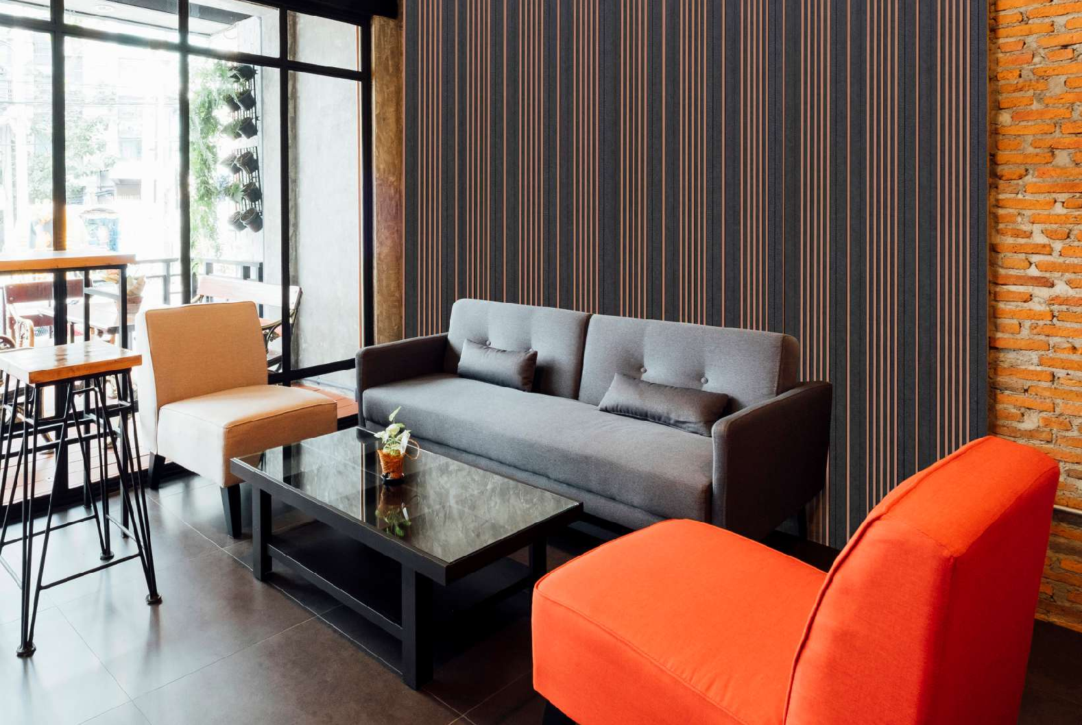
FLUTED WPC WALL PANEL ( 2 TONE ) 2900 X 160 X 22mm
RS26B
RS27B
RS28B
RS29B
RS30B

Slide 11
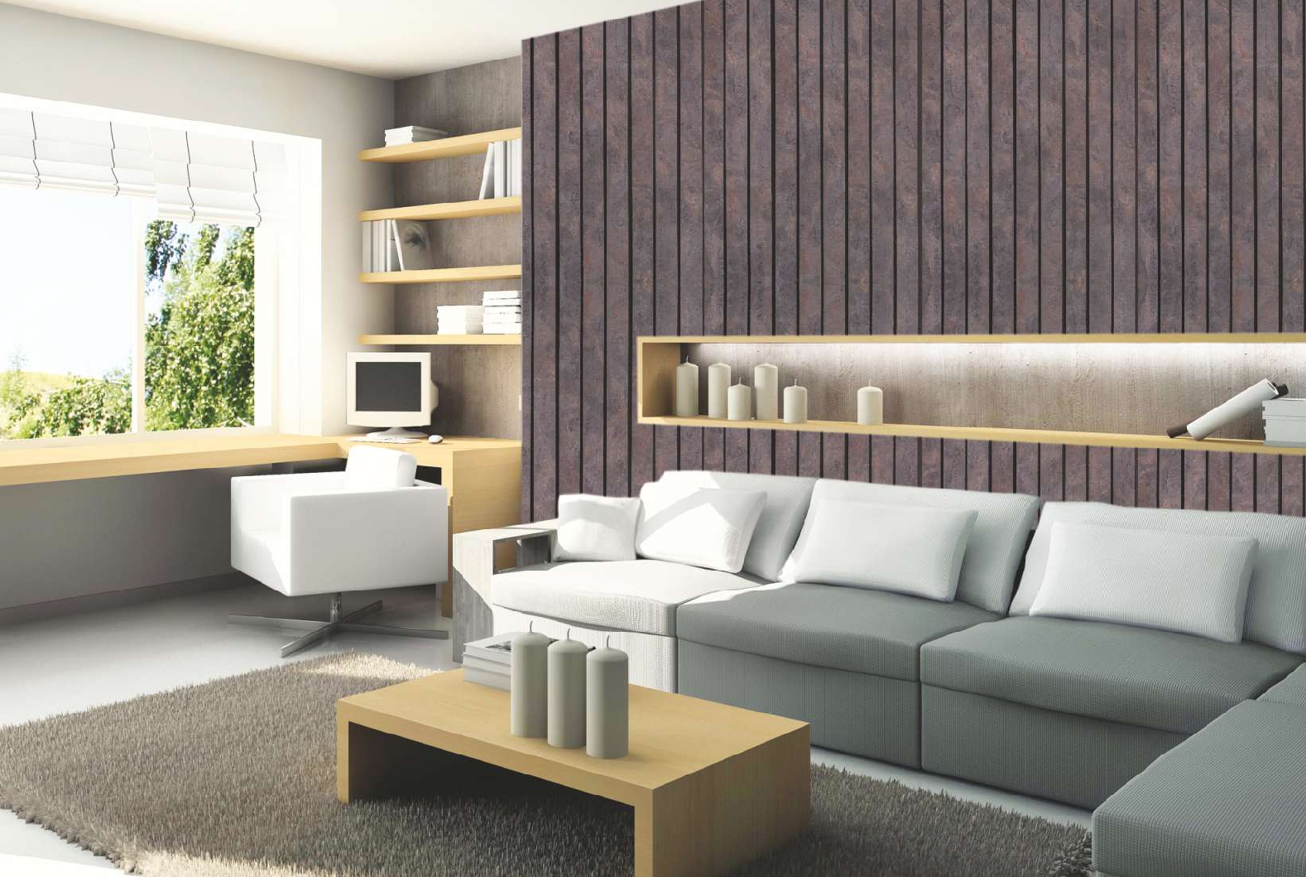
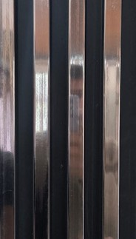
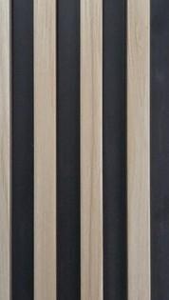

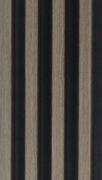
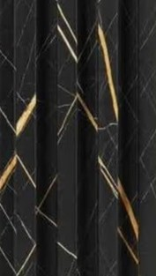
FLUTED WPC WALL PANEL ( 2 TONE ) 2900 X 160 X 22mm
RS31B
RS32B
RS33B
RS34B
RS35B

Slide 12
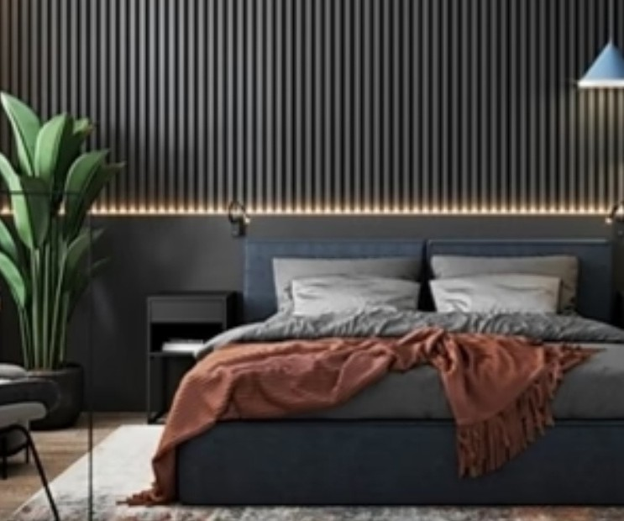
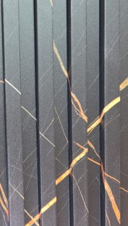
FLUTED WPC WALL PANEL ( 2 TONE ) 2900 X 160 X 22mm
RS35

Slide 13
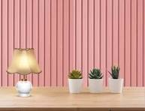




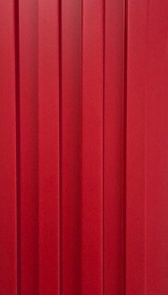
FLUTED WPC WALL PANEL 2900 X 160 X 22mm
Funky Designs
RS142
RS143
RS144
RS145
RS146

Slide 14
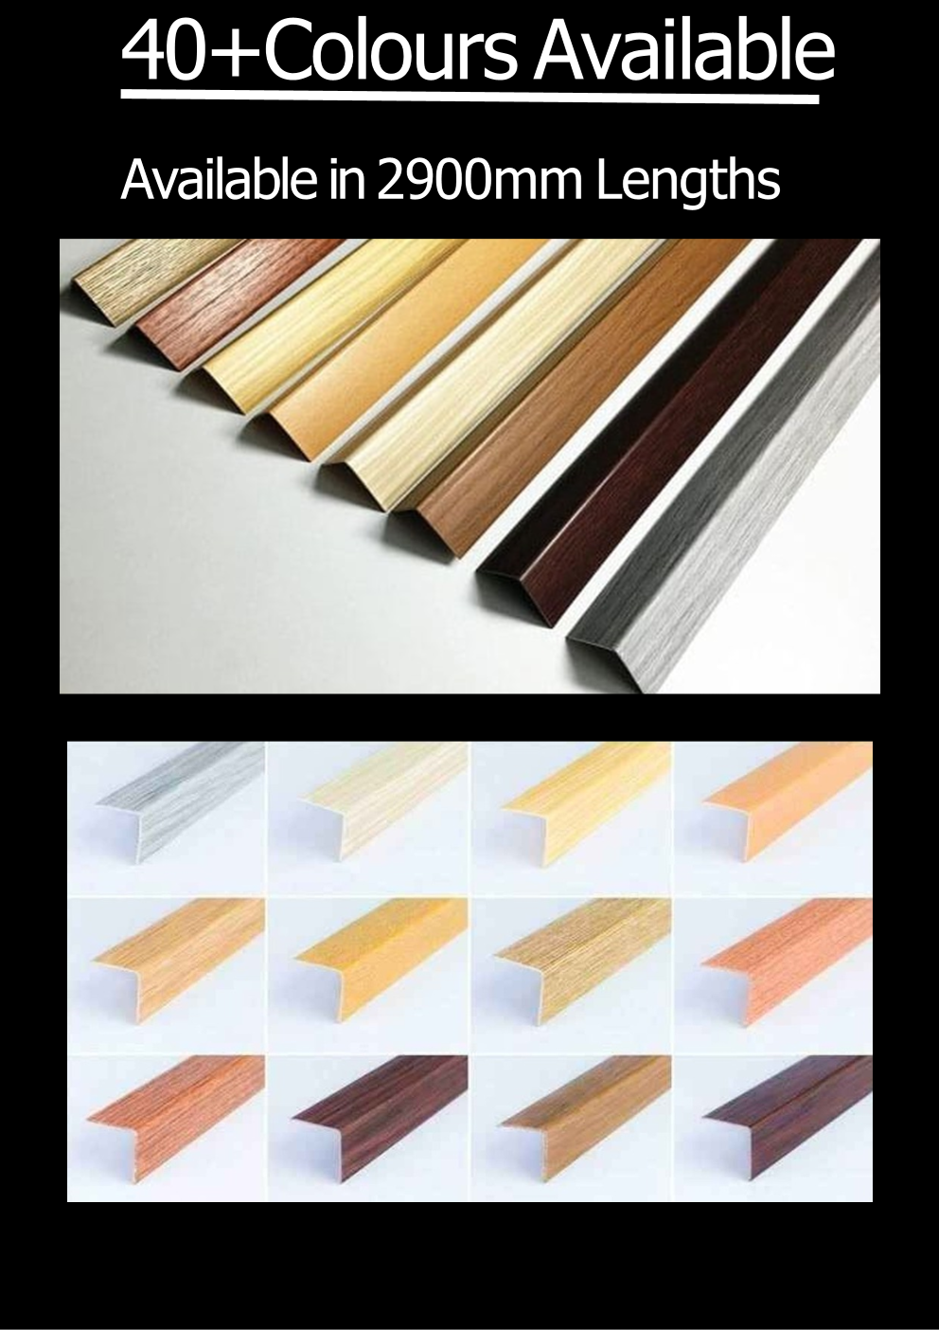

Slide 15
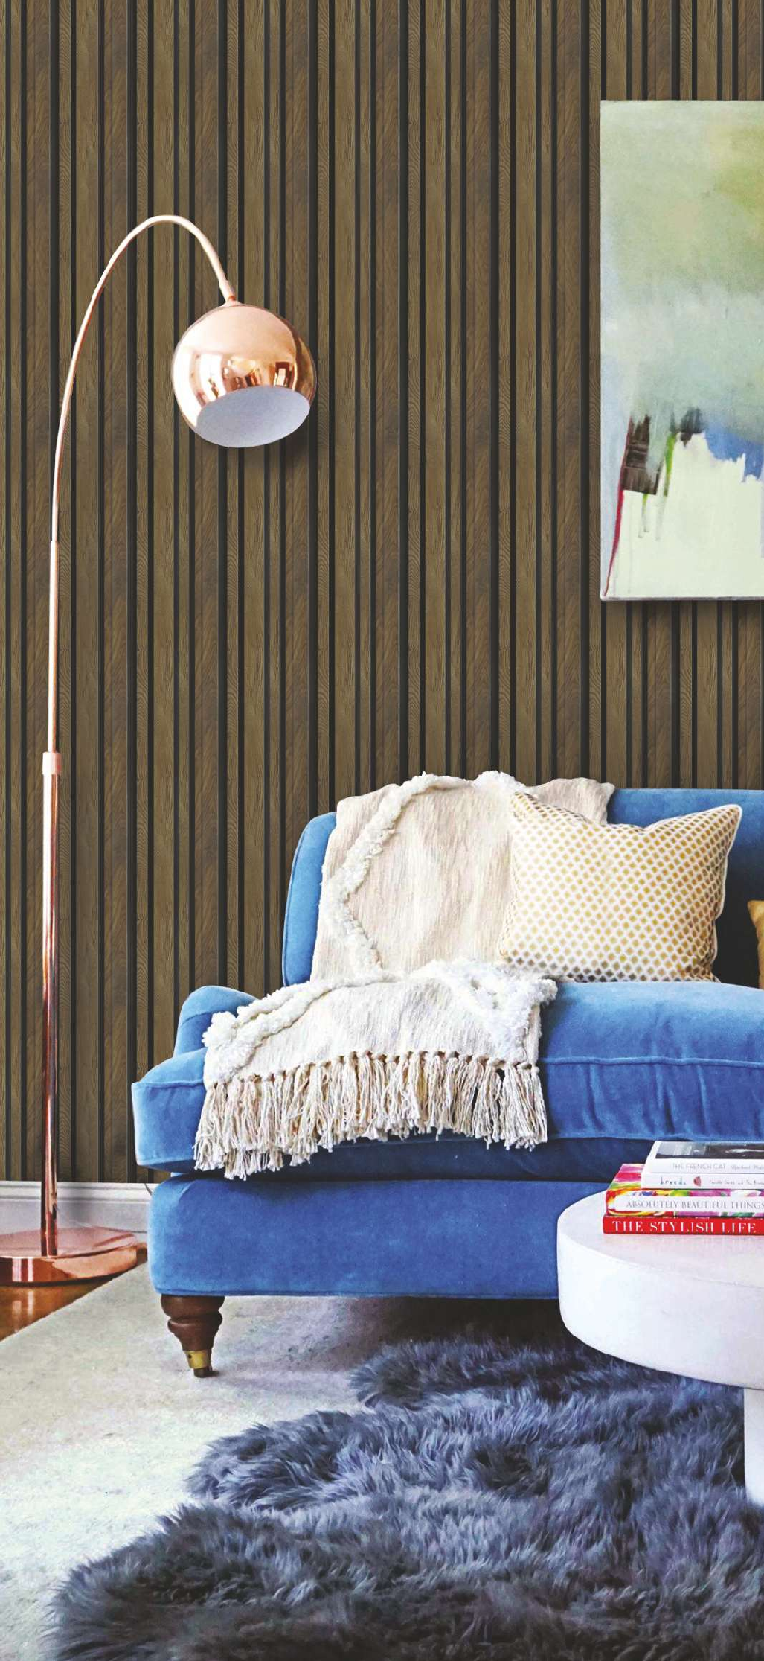

Slide 16
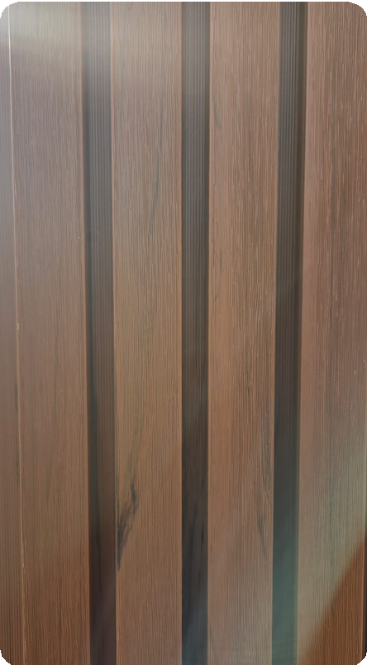
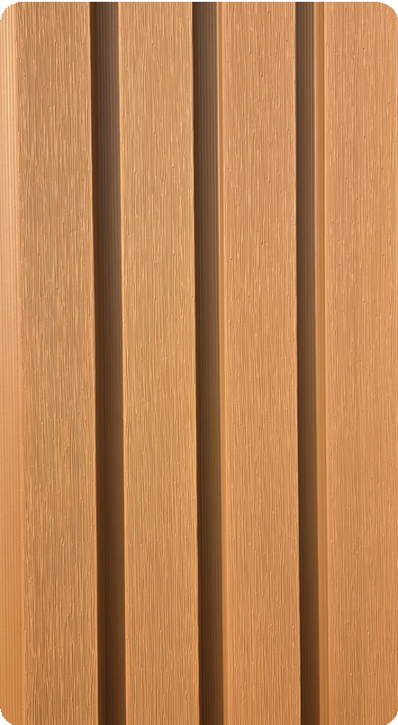







EXTERIOR FLUTED WALL PANEL WPC 2900 X 219 X 26MM
RS147
RS148
RS149
RS150
RS151
RS152
RS153
RS154
RS155

Slide 17









Mounting Clips
(4 piece) Swivel
RS161T
RS161B
Top Pair
Bottom Pair
RS156
RS157
RS158
RS159
RS160
WPC DIVIDER COLLECTION 2900 X 100 X 50mm

Slide 18




FLUTED PVC WALL PANEL 3050 X 305 X 8,5mm
RS162
RS163
RS164

Slide 19




FLUTED PVC WALL PANEL 3050 X 305 X 8,5mm
RS165
RS166
RS167

Slide 20




FLUTED PVC WALL PANEL 3050 X 305 X 8,5mm
RS168
RS169
RS170

Slide 21




FLUTED PANEL PVC 3050 X 305 X 8,5mm
RS171
RS172
RS173

Slide 22



FLUTED PANEL PVC 3050 X 400 X 8,5MM
RS174
RS175

Slide 23




FLUTED PVC WALL PANEL 3050 X 305 X 8,5mm
RS176
RS177
RS178

Slide 24





FLUTED PVC WALL PANEL 3050 X 305 X 8,5mm
RS179
RS180
RS181
RS182

Slide 25




FLUTED PVC WALL PANEL 3050 X 305 X 8,5mm
RS183
RS184
RS185

Slide 26


PVC WALL PANEL 2400 X 1200
RED ONYX
Red onyx are types of onyx that feature warm, earthy undertones. These stones can range fRS rusty red to chocolate brown and are often characterized by bands or veins of contrasting color. Red and brown onyx are highly prized for their natural beauty and warm aesthetic.
RS186

Slide 27




PVC WALL PANEL 2400 X 1200
LAVANTE
LAVANTE is a variety of Italian marble with a red-purple color already used by the RSans for the construction of columns, floors and walls. The background of this stone is characterized by a predominantly reddish pigmentation, due to the presence of iron oxides, on which a striking and dense interweaving of glossy white veins stands out.
RS187
RS188
BLACK MARQUINA
Black represents luxury and high-end design, which makes Black Marquina the most desirable marble. This marble is a timeless classic that lends an authentic appearance to the structure. The rich, dark black color with striking gray or white fissures
black Marquina marble disseminating the glory of its hierarchy on the market, but so are its types. This marble adds prestige and splendor almost everywhere it is utilized, including in interior design projects, wall claddings, countertops, and flooring.

Slide 28



PVC WALL PANEL 2400 X 1200
RS189
STATUARIO
Statuario is inspired by a famous Italian marble with a white bright background covered by elegant gray veins that run across the stone. This is a perfect and timeless choice that makes any space and design with a stunning aesthetic.
RS190
RS191
SMOKED DARK OAK
CREMA ZAFRA

Slide 29






PVC WALL PANEL 2400 X 1200
BROWN EMPRADOR
BOTTOCHINO
RS192
RS193
ONYX TROPICAL
SILVER TRAVERTINE
RS194
RS195
SILVER PORTORO
BLACK EMPRADOR
RS196
RS197

Slide 30






PVC WALL PANEL 2400 X 1200
AZALIA BLACK
BEIGE TRAVERTINE
RS198
RS199
PVC WALL PANEL 2700 X 1200
MARBLE 03
BRICKS DARK
RS200
RS201
RSANO 01
RSANO
RS202
RS203

Slide 31






PVC WALL PANEL 2700 X 1200
RSANO 03
BRICKS LIGHT GREY
RS204
RS205
CONCREAT SAND
BAMBOO
RS206
RS207
WOOD BLOCKS
CONCREAT FINE GRAIN
RS208
RS209

Slide 32




PVC WALL PANEL 2700 X 1200
RS210
CONCREAT WALL
RS211
LIGHT GREY MARBLE

Slide 33













UV PANEL HIGH GLOSS
PVC WALL PANEL 2400 X 1200
RS212 RS213
RS214
PVC WALL PANEL 2400 X 1200

Slide 34











UV PANEL HIGH GLOSS
PVC WALL PANEL 2400 X 1200
RS215
RS216
RS217
RS218

Slide 35





UV PANEL HIGH GLOSS
PVC WALL PANEL 2400 X 1200
RS253
RS254
RS255
RS256
GREY&GOLD

Slide 36





PVC WALL PANEL 2400 X 1200
Textured UV Panels
RS219
RS220
R221

Slide 37







PVC WALL PANEL 2400 X 1200
RS222
RS223
RS224
RS225

Slide 38






PVC WALL PANEL 2400 X 1200
RS226
RS227
RS228
RS229

Slide 39



PVC WALL PANEL 2400 X 1200
RS230
RS231
RS232

Slide 40






PVC WALL PANEL 2400 X 1200
RS233
RS234
RS235
RS236

Slide 41








NEW FLUTED DESIGNS
PVC WALL PANEL 2400 X 1200
RS257
RS258
RS259
RS260
RS261
RS262
RS263
RS264

Slide 42



NEW MIRROR TAPE
20mmx6mt /40mmx3mt /40mmx6mt
The Perfect Finish For Modern Spaces!
Mirror D.I.Y Tape Is Of The Highest Quality, Is Easy to Use And Cost-Effective.
Our Mirror D.I.Y Tape Offers A Simple Peel & Stick Application For All Your D.I.Y Projects.
The Simplest Way To Add Elegance To Your Space With Its Brilliant Mirror Finish.
Ideal For Accent Walls, UV Marble Panel, WPC Wall Panels & Any Other Smooth Surfaces.

Slide 43




STALLITA: Reflection of Luxury
“Where your morning routine becomes a retreat.” Stallita is dedicated to the sanctuary of the bathroom. We believe utility should never compromise beauty.
Our curated collection of luxury bathroom vanities and intelligent LED mirrors combines soft illumination with sophisticated storage, ensuring your most private space is also your most stylish.
RS237
700 X 700
RS238
700 X 700

Slide 44



RS239
800 X 600
RS240
800 X 600

Slide 45







RS241
800 X 600
RS242
800 X 600
RS243
800 X 600
RS244
800 X 600
RS245
800 X 600
RS246
800 X 600

Slide 46





RS247
700 X 500
RS248
700 X 500
RS249
700 X 500

Slide 47





RS250
1400 X 450
RS251
1400 X 450
RS252
1400 X 450

Slide 48






White 600mm
800mm
1200mm
Haven (Grey) 600mm
800mm
Black (Slate Charcoal) 600mm G/B M/B
800mm G/B M/B
Slate (Charcoal) 600mm
800mm
1200mm
Shale 600mm
800mm
Black Brookhill
600mm G/B M/B
800mm G/B M/B

Slide 49













Lily L345xW345xH140
Breva L380xW380xH200
Cornia L525xW440xH14
Candy L345XW300XH130
Lara L325XW270XH125
Civik L400XW400XH150
Sigma L400XW400XH160
Citizen L495XW360XH360
Neo L475XW435XH170
Cubic L430XW335XH130
Cuba L345XW300XH130
Luxora L400XW400XH15
Toto L415XW343XH168

Slide 50













Kolar Thunder
Kolar Black Gloss
Kolar Black Matt
Kolar Ocean Matt
Kolar Choco Matt
Kolar Smoke Matt
Kolar Matt Beige
Kolar Olive Matt
Kolar White
Marble Gloss White L450XW350XH120
Marble Gloss Grey L450XW350XH120
Marble Gloss Black L450XW350XH120
Marble Gloss Beige L450XW350XH120

Slide 51








Marble Gloss White L455XW325XH135
Marble Gloss Beige L455XW325XH135
Marble Gloss Granite L455XW325XH135
Marble Matt White L455XW325XH135
Marble Gloss Grey L455XW325XH135
Marble Matt Black L455XW325XH135
Topaz Gold & White Art 490x380x130mm
Topaz Gold & White Art 500x380x120mm

Slide 52











Cecelia Matt Rose Gold & Black 500x380x125mm
Cecelia Matt Black & Rose Gold 500x380x125mm
Cecelia Blue Marble Pattern 500x380x125mm
Laurel Pearl Glaze 375x375x1330mm C-2897
Laurel Matt Black 375x375x130mm C-2896
Laurel Matt Khaki 375x375x130mm
Laurel Matt Dark Blue 375x375x130mm
Alyssa Diamond White & Gold 360x360x125mm
Alyssa Diamond White & Gold 400x300x140mm
White 600X480X190 C-2485
White 800X480X190 C-2489

Slide 53








The Heart of the Kitchen
“Smart solutions for the modern culinary artist.” Croia redefines the kitchen workstation. From hand-crafted sinks to the high-tech functionality of our smart sinks and pull-down faucets, we cater to both the home chef and the professional contractor. With a dedicated contract range and specialized prep bowls, Croia combines industrial strength with sleek, contemporary lines.
Multi-function Kitchen Sink (Advanced) Black
Multi-function Kitchen Sink (Advanced) GOLD
Multi-function Kitchen Sink (Intermediate) Black
Multi-function Kitchen Sink (Intermediate) GOLD
Multi-function Kitchen Sink (Essential Plus) Black
Multi-function Kitchen Sink (Essential Plus)
GOLD

Slide 54












Kitchen Sink H/M One & Half Bowl - Satin 430x390x210mm
Kitchen Sink H/M One & Half Bowl - PVD Black 430x390x210mm
Kitchen Sink H/M Single Bowl - Satin 600x450x210mm
Kitchen Sink H/M Single Bowl - PVD Black 600x450x210mm
Kitchen Sink H/M Double Bowl - Satin 780x430x210mm
Kitchen Sink H/M Double Bowl - PVD Black 780x430x210mm
Kitchen Sink H/M Double Bowl - Satin 820x450x210mm
Kitchen Sink H/M Double Bowl - PVD Black 820x450x210mm
Kitchen Sink H/M Double Bowl - Satin 1200x500x210mm
Kitchen Sink H/M Double Bowl - Black 1200x500x210mm

Slide 55








Drop In Sink Double
Drop In Sink Single
Sit On Sink Double
Sit On Sink Single
Eco Drop In Sink Double
Eco Drop In Sink Single
Kitchen Cabinet Steel Double White
Kitchen Cabinet Steel Single White
Kitchen Cabinet Steel Single Black
Kitchen Cabinet Steel Double Black

Slide 56






Kitchen Sink Round 490x490x170mm
Kitchen Sink Round 410x410x170mm
Kitchen Sink Square 500x400x170mm
Kitchen Sink Square 430x370x170mm
Kitchen Sink Oval 570x450x170mm
Kitchen Sink Oval 770x500x170mm

Slide 57






Kitchen Sink Mixers - Pull Down
Kitchen Mixer Pull Down Chrome - 111
Kitchen Mixer Pull Down Matt Black - 112
Kitchen Mixer Pull Down Chrome & Matt Black - 107
Kitchen Mixer Pull Down Matt Black - 108
Kitchen Mixer Pull Down Chrome - 109
Kitchen Mixer Pull Down Matt Black - 110

Slide 58
















Sink Mixers
Basin Mixer Matt Black- 116
Basin Mixer Matt Black
Kitchen Mixer Matt Black- 101
Kitchen Mixer Matt Black-103
Basin Mixer Square Matt Black Neck Long
Kitchen Mixer Matt Black -119
Kitchen Mixer Black - 106
Kitchen Mixer Red - 105
Basin Mixer Chrome - 115
Basin Mixer Satin - 117
Kitchen Mixer Chrome - 102
Kitchen Mixer Chrome - 104
Kitchen Mixer Chrome - 113
Kitchen Mixer Satin Chrome - 114
Kitchen Mixer Chrome - 118
Kitchen Mixer Gold - 120

